Slide 1


Families First
News sharing
Keeping in Touch
Karen Dorney
Head of Service
SUPPORTING FAMILIES | CHILDRENS SERVICES
February 2026

Slide 2



Workforce Development
Join a Families First Induction day - ideal for new starters
We host Families First online Induction days 4 times per year, where various early help services give a 20 minute whistle-stop tour of their service and are attended by new internal CS staff and external partners. Our next date is Wednesday 18 February 2026 via Teams. If you have any new staff or would like to hear more about early help services, please email: familiesfirst.support@hertfordshire.gov.uk
Consider a Workforce Shadowing Opportunity
Workforce shadowing provides a great opportunity to find out more about other services, what they do and how they might be able to support you in your work. It also enhances communication across agencies and helps strengthen and develop professional relationships, building local networks. Visit Workforce development to make a request
Working Together in Early Help events – Spring dates coming soon
Held twice per year in person at venues across the county. Presentations and training from partner services.
Dates and booking link to be shared soon!

Slide 3

HCC Children’s Services
Participation Team
The team are currently looking for young people aged 16–25 to join our Diversity & Inclusion Young People’s Group
We are particularly seeking individuals who are passionate about influencing positive change within Hertfordshire services. The group will include young people from a range of backgrounds, including different cultures, ethnicities, and the LGBTQ+ community
The insights and feedback from this group will feed directly into the Hertfordshire Diversity & Inclusion Board, ensuring young people’s voices are heard and helping us work towards a more inclusive county.
If you are working with any young people who you feel may be interested in joining, please do get in touch. Our first session is scheduled for:
Tuesday 3rd March, 18:00–20:00 at Farnham House.
If you would like any further information, please contact:
Brooke.Donovan@hertfordshire.gov.uk
www.hertfordshire.gov.uk/participationteam
Participation Team - YouTube

Slide 4

HSCP Multi-agency Child Exploitation Strategy
The HSCP have developed a Child Exploitation Strategy, which can be accessed here website.
This Strategy establishes a unified approach to recognising, assessing, referring, and responding to child exploitation across the county. It ensures that professionals use a consistent process and set of tools, aligned with local arrangements and national guidance, to safeguard children at risk of exploitation.
The Strategy promotes a coordinated, multi-agency response that places the child at the centre of decision-making and reflects the principles of Working Together to Safeguard Children and the Home Office’s Child exploitation disruption toolkit.

Slide 5

FREE Webinar - Child Sexual Abuse: Emerging online threats to our children
19th February 2026 12:30-13:30
Martin Grace - Child Sexual Abuse Threat Lead at the National Crime Agency will speak about the general threat picture relating to online Child Sexual Abuse and the emergence of Com Networks
Please contact Chelle Farnan
at england.eastsafeguarding@nhs.net for a link to join

Slide 6

Hertfordshire's Victim Awareness Conference 2026
Tickets now available for Hertfordshire's Victim Awareness Conference 2026 on Tuesday 24th March!
Beacon's Annual Victim Awareness Conference at the Fielder Centre for a day of learning, networking and reflection.
This event is all about raising awareness for victims of crime and what they want us to know as professionals in how to respond and support them.
Whether you're in a victim advocate role specifically or a Hertfordshire professional or community member who might encounter victims in their work, this conference is for you
To book https://BeaconVictimsAwarnessConference2026.eventbrite.com

Slide 7

Suicide Bereavement Training Course Offer - FEB - MAR 2026
Public Health are offering funded places on a Hertfordshire Suicide Bereavement Training Course.
When and Where: There are five online sessions available between 19 February and 16 March. Each session lasts four hours.
Why: We are keen to ensure staff and volunteers on the frontline feel supported, confident, and equipped to manage this highly sensitive and challenging area of work.
Who for: Please do share this opportunity with your teams/partners as appropriate and encourage staff/volunteers to book as soon as possible to secure a place.
Booking: Public Health Training | Hertfordshire County Council
MORE INFO:-

Slide 8
NHS England Tik Tok Safeguarding Alert
Action suggested:
To remind parents/carers and the bill payer of any mobile device, of their responsibility to monitor the content and share any safeguarding concerns.
Individuals and teams to consider any contact vulnerable children or young adults maybe having with the digital community or following online
Inpatient units to ensure all policies and process are followed when visits are arranged by external parties/adults
To ensure parents/carers have access to resources available to support safe online activity.
We have been made aware by Essex Children’s Services, of some concerning activity relating to, two young adults, who may be having contact with CYPs on or previously on, CAMHS inpatient wards and are encouraging self-harm.
Our concern relates specifically to the potential of previous and possible current connections, with these two individuals, and a TikTok account which our CYP’s may be following. One of the individuals has approximately 3,000 followers on TikTok and appears keen to maintain this following, which may be a motivating factor for them to engage with vulnerable young people.
Read More here:

Slide 9
Free - Introduction to working with separated migrant children
1 hour training sessions available between: 19-03-2026, 19-06-2026
How professionals involved in the care of migrant children can support them
Who are migrant children and why do they come to the UK?
Legal and policy framework
Upholding their rights
Protection and safeguarding (including risks and vulnerabilities
Psychosocial Support and Trauma-Informed Care
Cultural competency
Multi-Agency collaboration
Vicarious trauma and self-care
Who is this training for?
Social workers, and anyone working, engaged, curious or interested in engaging with separated migrant children in different capacities and organisations
Please visit HSCP training platform website.

Slide 10

NEW: Relationships, Sex and Health Education (RSHE)
Statutory guidance and curriculum training opportunity
Department for Education published updated RSHE guidance in July 2025, must be implemented in schools by 1st September 2026
Hfl Education running sessions on new guidance
For professionals working in PH, CYP services, drug and alcohol, youth settings and other community based services
Links to book:
Wedneday 25th February 2026 11.00am - 12.15pm
Wednesday 18th March 2026 13.45pm - 15.00pm

Slide 11
OFFICIAL: UKHSA Health Protection Briefing Note
This relates to contaminated non-sterile alcohol-free wipes. These may be in first aid kits, used in special schools, children’s residential settings.
Summary:
This is an update to Briefing Note 2025/033 (issued 04 August 2025) on the continuing outbreak of Burkholderia stabilis ST480 linked to non-sterile alcohol-free wipes.
Key updates:
UKHSA have issued an urgent public health message and an updated press release on 05 February 2026.
READ MORE HERE:
Action- These products, previously used for ‘skin cleansing’ and wound cleaning, have been withdrawn from sale but may still be in homes and first aid kits. Providers should check all first aid kits in use and remove and dispose of any affected products ( list of affected products within attached briefing note).

Slide 12

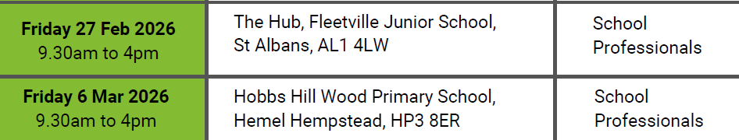
Youth Mental Health First Aid Training
Email to book : schoolsmh@hertfordshire.gov.uk

Slide 13


Herts Vision Loss – Vision in Motion

Slide 14

Fifty Thrifty: Exciting Half-Term Adventures Await in Hertfordshire!
Our central HCC comms team have curated a list of fifty fantastic ‘no cost’ or ‘low cost’ activities that promise endless wonder and excitement children.
Please promote to families:- Hertfordshire County Council | Fifty Thrifty: Exciting Half-Term Adventures Await in Hertfordshire!

Slide 15
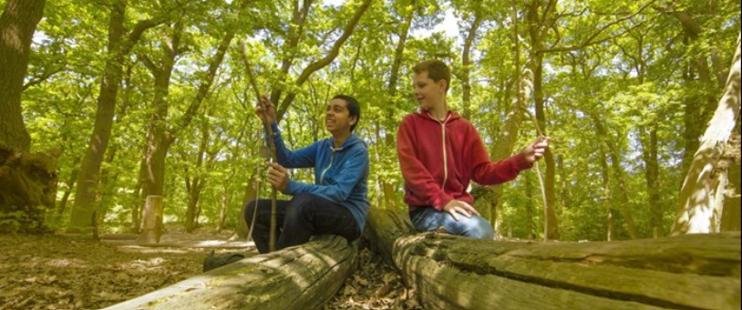
SfYP – Free February half term activities for young people with SEND
16- 18 February (half term) at Hudnall Park
Free adventurous outdoor activities for 13-19 CYP with SEND
Funded by HCC Short Breaks
Please signpost CYP with SEND or their parents carers to SfYP website to sign up
sign up here
Services for Young People

Slide 16
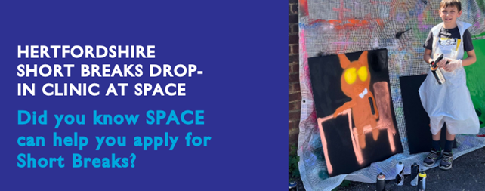
SPACE – Short Break (SBLO) Clinic –
Free 1:1 Advice Sessions
Please let your families know that Space are offering free, bookable 25 minute one-to-one advice sessions with SPACE’s Short Breaks (SBLO) Coordinator.
These sessions will help you understand Hertfordshire Short Breaks, including who can apply, how to use your hours, and how to access local providers, including SPACE.
If helpful, our SBLO Coordinator can also support you to complete your application during the session.
Find out more here.
Book appointments here

Slide 17

Family Centres Partnership Network
Feb-Mar dates and bookings open
Dacorum
East Herts
Hertsmere
St. Albans
Stevenage and North Herts
Watford and Three Rivers
Welwyn/Hatfield/Broxbourne
For dates, times and bookings :
Hertfordshire Family Centre Service Events - 26 Upcoming Activities and Tickets | Eventbrite

Slide 18

Beezee Families
Beezee Families, a FREE heathy lifestyle programme that our nutritionists deliver across Hertfordshire.
Their current programmes are in full swing but you can secure a FREE spot now for April.
Visit our website for more details

Slide 19
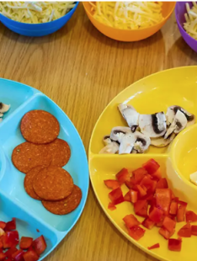
Community Wellbeing North Herts - Fun with Food for Families :
Baldock, Hitchin, Royston, Letchworth, Knebworth
Join us for this 30-minute interactive, hands-on cooking session for children under 5 with their adult. Join Angie from Creative Chefs to discover a variety of seasonal vegetables and fruit in a fun, stimulating environment.
For more information about Creative Chefs, follow the link to their website: Home - Creative Chefs CIC
We asked participants to pay a £1 contribution for their ingredients.
For more information please contact: communitywellbeing@north-herts.gov.uk or call 01462 474111
For dates and to book : Events | Health Hub North Herts

Slide 20

Healthy Homes for Heathier Lives
Free training sessions for professionals working with individuals whose health may be affected by poor-quality housing.
This session aims to strengthen learners’ knowledge, understanding, and awareness of what makes a home healthy and why this is essential for both physical and mental wellbeing.
Spaces available on : 3rd March at 10:00am
Please book a place via the Public Health Training webpage
Public Health Training | Hertfordshire County Council

Slide 21


Flourish – Refugee and Asylum Seeker Service Referrals Open
Flourish (our commissioned MH and wellbeing support service for refugees and asylum seekers delivered by Herts Mind Network) are open again to new referrals
Flourish – Refugee and Asylum Seeker Service | Hertfordshire Mind Network

Slide 22


Supporting Links
Free Online courses starting February
6 weekly sessions for parents and carers
TALKING FAMILIES - children aged 0-12
Thursdays 7.45 - 9.15pm,
5th Feb to 19th Mar, Online Course: ID 803
TALKING ANXIETY - children 3-19
Wednesdays 7.45 - 9.15pm
11th Mar to 29th Apr, Online Course: ID 802
TALKING TEENS - children aged 12-19
Wednesdays 9.45 - 11.30am
4th Feb to 18th Mar, Online Course ID 801

Slide 23
Relationship Support - survey
We would now like to revisit a survey we ran in 2023 to understand how well the current offer is meeting needs, identify any remaining gaps, and understand future training requirements to help shape the relationship support offer for 2026–27.
Please could you take 5 minutes to complete this survey:-
Relationship Support Offer Professionals Survey 2026

Slide 24

Relationship Support
When working with families do you think about the quality of parental relationships?
Do you feel confident to ask questions about relationship quality?
Do you know where to signpost for relationship support?
We understand that healthy relationships support good outcomes for children, so it is essential that we support parents to have the skills to manage stress and communicate well.
Arguing is NORMAL it is our behaviours and how we resolve conflict that determine relationship quality and stability.
The Strategic Partnerships Commissioning Team have developed an i-learn that we can share for free if you have a learning platform you can host the course on.
It covers:
Understanding what parental conflict is and the impact this has on Children and Young People
Understanding the difference between parental conflict and domestic and the appropriate support pathways
Identifying signs that could indicate relationship distress and conflictual behaviours that lead to relationships breakdown
Understanding a framework for working with parents in conflict
We offer free training in the use of the OnePlusOne Digital Interventions and are looking for relationship support champions across the VCFSE sector.
We have developed a webpage full of resources and courses to support parents in conflict Relationship support for parents | Hertfordshire County Council
We have commissioned 3 online courses for parents through the charity OnePlusOne
Me, You and Baby Too
Arguing Better
Getting It Right for Children
We have practitioners trained across the Family Centre Service and Local School Partnerships that can support parents and carers through the digital resources or parents can be signposted to complete the resources independently by creating a free account
We have trained practitioners and commissioned providers delivering group interventions for parents
Parenting When Separated
Co-Parenting with Care for parents of children with SEND
Stronger Relationships
If you would like to know more about the training, resources and courses available to support parental relationships please contact CSStrategic.Partnerships@hertfordshire.gov.uk
Hertfordshire County Council

Slide 25

Parenting Courses
Targeted parenting courses are commissioned by Strategic Partnerships Commissioning team, within the Joint Children’s and Young People Commissioning Service and through the Targeted Parenting Framework (TPF).
They will meet the most common parenting needs in Hertfordshire and will be a key contributor to the overall package of support that a parent receives. Parenting courses to be delivered as part of a wider package of intervention and not in isolation.
Six providers have been commissioned through the Strategic Partnerships Commissioning team :-
ADD-vance
Families in Focus
Family Lives
Families feeling safe
SPACE
Supporting links.
There is NO cost for families to attend.
Further information about workshops can be
found on The SEND Local Offer and
Parenting directory .
Links to special edition newsletters:
Families First News – Parenting & Relationship Support
Families First News - Welcome to the Workforce Development Special Edition

Slide 26
Key Families First Links
Keep up-to-date by reading o
latest Families First:
Families First News
Link to support for families:-
Families First Website
Professionals area:-Early Help – information for professionals and partners
For Families First partnership
groups, news sharing and general info email:- familiesfirst.support@hertfordshire.gov.uk
Ensure your service is listed on the Hertfordshire Directory:- Register to add a listing | Hertfordshire Directory

Slide 27








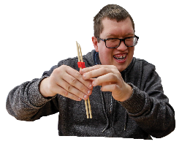

Early Help Consultations & Personalised Commissioning
Supporting Families Partnership Team - Information for Partners

Slide 28


Early Help Consultations
Purpose:
To provide guidance to partners supporting children and families who need additional help but do not meet the threshold for safeguarding or statutory intervention.
Process:
Book a 15‑minute consultation via email with your Families First Coordinator.
Consultations will be held on Mondays and Thursdays.
If FFA or Support request is recommended, the FFC will help initiate and follow up
Creating a cleaner, greener, healthier Hertfordshire

Slide 29
Early Help Consultations
What they offer:
Advice on Early Help pathways, local services, criteria, and referral options.
Support with understanding when a Families First Assessment (FFA) may be helpful.
Anonymous discussions possible; consent preferred.
What they don’t cover:
Safeguarding or child protection concerns.
Accessing information on existing open FFAs.
Creating a cleaner, greener, healthier Hertfordshire

Slide 30
Personalised Commissioning
Purpose:
To fund goods, services, or activities needed by a family that cannot be met by existing services or other funding routes—but only when an active FFA and TAF plan are in place.
Applications must:
Be made by the Key Worker leading an active FFA.
Have held a TAF meeting within 2 weeks of applying (and have updated EHM).
Evidence that the TAF discussed the request and agreed the outcomes.
Capture the child’s voice clearly, especially for activity/club funding.
Creating a cleaner, greener, healthier Hertfordshire

Slide 31
Personalised Commissioning
What can be funded:
Sensory/play equipment
White goods
Emergency/time‑limited childcare
Leisure clubs and holiday activities
Some counselling / interventions (ADDvance coaching, Apr–Dec)
What cannot be funded:
Activities during school hours
School‑only educational equipment (e.g., iPads)
Landlord‑responsible household repairs
Travel costs (except in rare, justified cases)
Services for needs requiring statutory provision
Creating a cleaner, greener, healthier Hertfordshire

