Slide 1


Families First
News sharing
Keeping in Touch
Karen Dorney
HEAD OF SERVICE
SUPPORTING FAMILIES | CHILDRENS SERVICES
August 2025

Slide 2
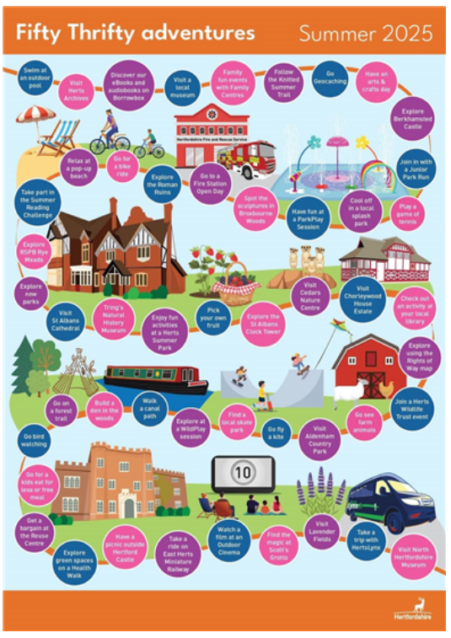
Fifty Thrifty Summer 2025
Our central Communications Team have put together another list of fifty cost-effective activities for families this summer for you to share with families you support
Wherever families are in the county, the summer holidays are a great opportunity to explore Hertfordshire. Choose one or more of the following low or no cost activities:-
Find out more here:- Fifty Thrifty Summer 2025
You can also download and display the poster :-
Fifty Thrifty Adventures - Summer Half term 2025 - A3 V2

Slide 3
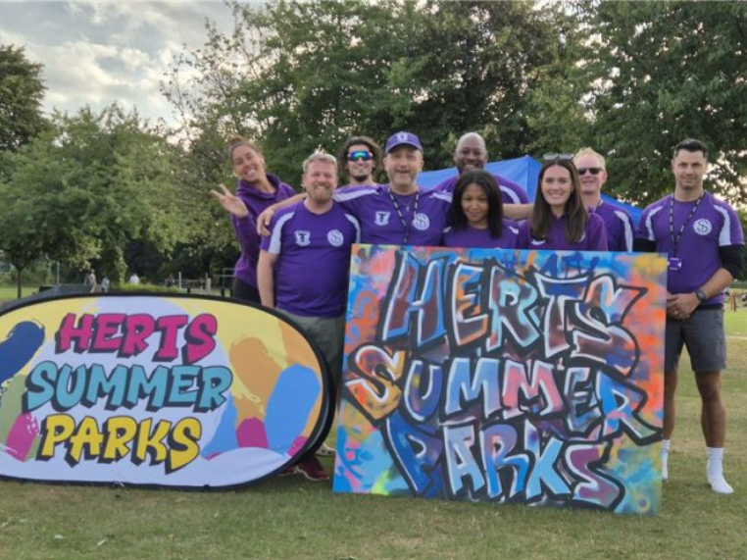
Herts Summer Parks – still time to join
Free park activities across Hertfordshire August 2025
Registration for Herts Summer Parks 2025 is now open. If you are aged 12–16 years, a parent or carer of a young person, you can sign up now which will enable fast track entry on the day: https://forms.office.com/e/NSu0aCDSpa
For full details on the activities running across the three-week programme and information about our food providers, please visit our website: https://sportinherts.org.uk/Summer-Parks
Event Dates and Locations:
Welwyn – King George V Playing Fields: Monday (4th, 11th, 18th) August
Watford – King George V Playing Fields: Tuesday (5th, 12th, 19th) August
Hertsmere – Meadow Park: Wednesday (6th, 13th, 20th) August
Broxbourne – Waltham Cross Playing Fields: Thursday (7th, 14th, 21st) August
Stevenage – King George V Playing Fields: Friday (8th, 15th, 22nd) August
A programme of FREE festival-style park events for teenagers across Hertfordshire during the summer

Slide 4
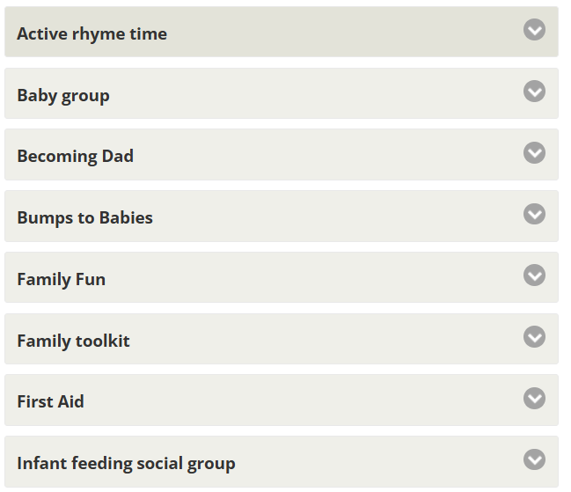
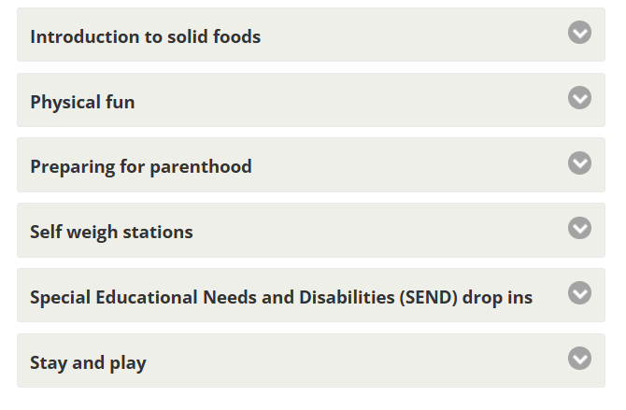

Summer Fun at the Family Centre
The Family Centre Service summer What's On page is now live! Please help raise awareness of the summer programme through sharing this information with the families you support:-

Slide 5
Beezee - Free Healthy Lifestyle Services
Sign ups for Autumn now open!
Beezee Families programme in 6 locations across Hertfordshire, commencing 22nd September 2025, with initial telephone appointments the week prior
Beezee Families LIVE online group programmes running and our year-round Beezee Families 1:1 intervention
FREE Beezee Youth teens wellbeing programme will be running online on Wednesdays FROM 6pm until 7pm for 8 weeks, starting 8th October 2025
HENRY 0-5s parenting support will begin in October 2025
Professional Referrals to Beezee programmes can be made in 4 ways:-
Call on 01707 248648
Via this link Refer a Client to Beezee
Email on beezee.bodies@nhs.net
Use the form on DXS/Ardens (health professionals only)
Self-referrals to Beezee programmes can be made in 3 ways:-
Call on 01707 248648
Via this link where they can complete a very short form and we will contact them
Email us at bzbinfo@maximusuk.co.uk

Slide 6
Calling Bengali Families
Please share this event with any Bengali communities –
open to all who identify with Bengali culture, a free event focused on health and wellbeing!
  St Albans, Saturday 30th August
  Venue: Summerfield health centre, Caledon road, London Colney, AL2 1PU
  Date: Saturday 30th August
  Time: 2-4pm
Please contact Summerfield Health centre for any queries.
Download the poster:

Slide 7

ESOL (English for Speakers of Other Languages) Date available with Step2Skills
Hertfordshire residents who have English as a second language and would like to feel more confident with English, they can improve their English reading, listening and speaking skills with Step2Skills!
They will need to attend an initial assessment session with Step2Skills in August to see what level they’re currently working at and from there, the team will offer them the most suitable course
Browse the days, times and venues of ESOL Initial Assessment sessions: Step2Skills | Hertfordshire County Council

Slide 8

New wave of mums to benefit from 24/7 breastfeeding support
The Government has extended the National Breastfeeding Helpline as part of a £18.5 million investment in infant feeding support through Family Hubs and Start for Life programme
Thousands of mothers and babies will benefit from extended support to breastfeeding services this year, so please share with any relevant families
National Breastfeeding Helpline :
0300 100 0212

Slide 9
My Baby’s Brain Training :
Autum courses available
💻 Delivered via Zoom
Free online training for professionals working with families and children aged 0–3
Help build strong foundations for babies’ development by understanding how early relationships and everyday interactions shape the brain.
My Baby’s Brain Training Universal
For: Professionals offering universal early years support (e.g. Health Visitors, Midwives, Family Centre staff)
To Learn:
· Introduction to the Five to Thrive model
· Understanding trauma and how everyday interactions
support recovery
Dates:
· 📅 Thursday 18 Sept 2025, 9:30am–3:00pm
· 📅 Wednesday 22 Oct 2025, 9:30am–3:00pm
Book here: KCA: Reg form: My Baby's Brain Autumn 2025 - Universal Services Workforce
My Baby’s Brain Training Targeted
For: Professionals supporting vulnerable families (e.g. Family Safeguarding, Specialist Services, specialist midwifery)
To learn:
  The importance of attachment and how early adversity can lead to developmental trauma
  Introduction to the Five to Thrive model for promoting secure relationships
  The impact of trauma and principles of trauma-informed practice
  Opportunities for reflection on practitioner vulnerability when working with traumatised individuals
Dates:
· 📅 Thursday 2 Oct 2025, 9:30am–3:00pm
· 📅 Wednesday 12 Nov 2025, 9:30am–3:00pm
Book here: KCA: Reg form: My Baby's Brain Autumn 2025 - Targeted Services Workforce

Slide 10

Neurodiversity Support Hub for parents, Carers and professionals
If someone has questions about neurodiversity, they can contact the Neurodiversity Support Hub for parents, Carers and professionals in Hertfordshire. The hub is staffed by experts by experience and does not require a diagnosis to access the support.
The Neurodiversity Support Hub is open Monday-Friday 9am-1pm, and the team can be contacted by phone at 01727 833963 or through email at supporthub@add-vance.org.

Slide 11

OnePlusOne Professional Training:
Relationship Support Courses
What can I expect to learn?
The session aims to enhance your knowledge, understanding, skills, and confidence to work with parents.
By the end of the training you will be able to:
Raise parents’ awareness of the issue of parental conflict.
Use digital resources to help parents recognise conflict.
Enable parents to develop positive communication skills and
helpful conflict behaviours.
How can I book onto the training?
Select your preferred date and follow the registration link to book your place.
This is a 3 hour digital training, which takes place on Microsoft Teams.
Wednesday 17th September 2025 9:30am – 12:30pm registration link
Tuesday 14th October 2025 9:30am – 12:30pm registration link
Monday 24th November 2025 9:30am - 12:30pm registration link
What does session cover?
The impact of parental conflict on children’s outcomes.
Background to the design of the digital resources.
Introduction to OPO digital resources.
Overview of the wider Relationship Support offer in Hertfordshire.

Slide 12


Relationship Support
The Strategic Partnerships Commissioning team have developed a webpage full of resources to support parents in conflict and a range of digital and group based courses:
Stronger Relationships: A 6-week group based course for co-parents living together or apart that focuses on managing stress and enhancing communication.
Parenting When Separated: A 6-week group based course for separated parents that focuses on the emotional impact of separation and supporting communication between co-parents.
Co-Parenting with Care: A 6-week group-based online course for parents and carers of neurodiverse children seeking guidance, support, and strategies for co-parenting more consistently.
OnePlusOne’s digital interventions: 3 online courses aimed at new parents, intact parents and parents that are separated:
Arguing Better
Me, You and Baby Too
Getting it right for children
Relationship support details
If you would like to know more about the training, resources and courses available to support parental relationships please contact CSStrategic.PartnershipsCommissioning@hertfordshire.gov.uk.

Slide 13

Parenting Courses
Targeted parenting courses are commissioned by Strategic Partnerships Commissioning team, within the Joint Children’s and Young People Commissioning Service and through the Targeted Parenting Framework (TPF).
They will meet the most common parenting needs in Hertfordshire and will be a key contributor to the overall package of support that a parent receives.
Parenting courses to be delivered as part of a wider package of intervention and not in isolation.
Six providers have been commissioned through the Strategic Partnerships Commissioning team :-
ADD-vance
Families in Focus
Family Lives
Families feeling safe
SPACE
Supporting links.
There is NO cost for families to attend.
Further information about workshops can be
found on The SEND Local Offer and
Parenting directory .

Slide 14
Key Families First Links
Keep up-to-date by reading o
latest Families First:
Families First News
Link to support for families:-
Families First Website
Professionals area:-Early Help – information for professionals and partners
For Families First partnership
groups, news sharing and general info email:- familiesfirst.support@hertfordshire.gov.uk
Ensure your service is listed on the Hertfordshire Directory:- Register to add a listing | Hertfordshire Directory

